Slide 1
UNIT 9:
An Ecosystem Approach to Fisheries Management Plan

Slide 2
EAFM plan
Activity 9.1: Assess prior experience in planning and developing management plans.

Slide 3
Development steps
Key components:
Define the scope of the plan
Define stakeholder engagement strategy/plan
Compile background information
Prioritise issues and define objectives
Select indicators and reference points
Identify management actions to achieve objectives
Design process whereby all management actions can be implemented
Design monitoring program including performance indicators (Unit 10)
Define the “review and management adaptation” process (Unit 10)

Slide 4
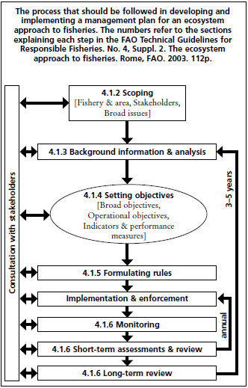
EAFM planning approach
p
FAO 2003
Notes:
The process that should be followed in developing and implementing a management plan for an ecosystem approach to fisheries. The numbers refer to sections explaining each step in the FAO Technical Guidelines for Responsible Fisheries No. 4. The ecosystem approach to fisheries. FAO, Rome. 2003. 112p

Slide 5
Define scope
1. Define scope of the plan
Geographic area
Fisheries of interest
Who are the stakeholders
List fisheries issues (refer to course notes)
Describe any current management
Describe all relevant jurisdictions
Activity 9.2: Use the EAFM plan template and outline the scope for your case study EAFM plan and list the key issues for the fishery/ies

Slide 6
Engagement plan
2. Define stakeholder engagement strategy
Stakeholder involvement needs to occur at all stages of EAFM plan development and implementation
Success will depend on stakeholder ‘ownership’
Need to consider:
Who are the stakeholders?
How to engage?
How often?
By whom?
Activity 9.3: Using your EAFM plan template list the relevant stakeholders for your case study and develop a stakeholder engagement strategy.

Slide 7
Background information
3. Compile background information
All available information on what was identified in i. (Scope) needs to be collated
Information types include:
Social and economic fishery characteristics
Fishery characteristics
Ecosystem
Governance
This will guide formulation of objectives
Activity 9.4: Identify potential sources for background information

Slide 8
EAFM objectives
4. Prioritise issues and define objectives
Objectives may be set at different levels
Broad objectives will
be determined by national policies
describe intended outcomes of the EAFM plan
cover all disciplines
Subordinate operational objectives will
provide more detail to broad objectives
be determined by key fisheries issues
be measurable and achievable
be determined by all stakeholders

Slide 9
EAFM objectives
Figure 9.2
Process for taking high level policy to broad objectives of the EAFM plan, to operational objectives and actions

Slide 10
Prioritise issues
Activity 9.5: Identify broad objectives for your case study EAFM plan (refer to course notes).
Need a prioritisation process to ensure that management efforts focus on the most important issues.
FAO suggest these three tasks involved:
Task 1: Under each of the broad objectives identify the detailed fishery issues (identified in i.).
Task 2: Prioritise the issues based on the level of risk they pose to the fishery.
Task 3: Develop operational objectives for the priority issues.

Slide 11
Prioritise issues
Task 1: Under each of the broad objectives identify the detailed fishery issues (identified in i.).
Activity 9.6: Assign previously identified fishery issues to each broad objective.

Slide 12
Prioritise issues
Task 2: Prioritise the issues based on the level of risk they pose to the fishery.
qualitative (opinion-based) quantitative (data-based)
1. Pairwise issue ranking
 | Issue 1 | Issue 2 | Issue 3 | Issue 4 | Issue 5 | etc
Issue 1
Issue 2
Issue 3
Issue 4
Issue 5
etc

Slide 13
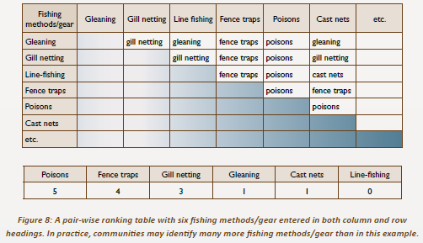
Prioritise issues

Slide 14
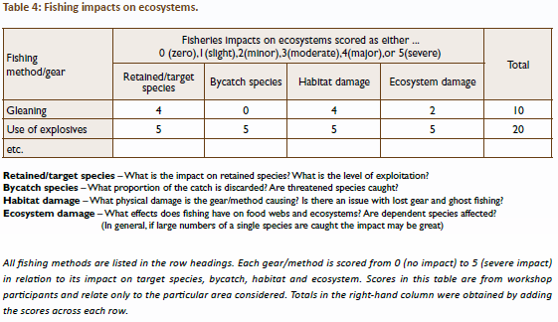
Prioritise issues
2. Quantitative ranking (SPC, 2010)

Slide 15
Prioritise issues
Activity 9.7: Prioritise issues for your case study using either a qualitative or quantitative risk assessment method.
The plan should document each of the issues identified, the level of priority given to each and how they were given the level of priority.

Slide 16
Operational objectives
Task 3: Develop operational objectives for the priority issues.
For each of the issues identified as being the highest priority an operational objective should be developed that addresses the issue. These objectives should be measurable and achievable.
Activity 9.8: Develop operational objectives for your case study EAFM plan for the priority issues (top 3-4).

Slide 17
Performance measures
5. Select indicators and reference points
(These were introduced in Unit 8)
The whole aim of setting these in our plan is so we have measureable attributes that we can use to assess how well our EAFM plan is achieving its stated objectives.
An indicator, and reference points for that indicator, should be selected for each operational objective.
Indicator should be:
Measurable
Feasible
Meaningful

Slide 18
Select indicators
Activity 9.9: Identify potential indicators that may be used for assessing each objective.

Slide 19
Management tools
6. Identify management actions to achieve objectives
For each objective brainstorm potential management actions
Need to consider the following for each action:
Ease of application
Likelihood of success
Feasibility
Cost
Use of a problem-solution tree may be valuable (Box 10; SPC, 2010)

Slide 21
Select tools
Activity 9.10: Identify potential management actions that could be used to achieve each operational objective. Justify your choices using the criteria:
- Ease of application
- Likelihood of success
- Feasibility
- Cost

Slide 22
Write the plan!
7. Design process whereby all management actions can be implemented
All the above elements need to be in a written plan (see EAFM plan template). Include details:
Nature of management actions
How applied
Administrative structures
Role of government & community
Funding sources
Implementation costs
Formal and informal arrangements
Review process (see Unit 10)

Slide 23
Formalise the plan
At this stage consideration to formalising the plan should be done.
Needs to be recognised and endorsed:
Community leaders
Government agencies
Non-government agencies
Legislation

Slide 24
Write the plan!
Activity 9.11: Using the EAFM plan template document all the above elements into an EAFM plan for your case study. Include identification of factors needed to be considered to formalise the plan, and how they may be addressed.
15 minute personal review: unit review, students to review main concepts of unit in the course notes, contribute any new words (new to them) to their own personal glossary in the back of their notebook (local language equivalent terms should also be recorded where possible)

Slide 25
Homework
Continue completing your EAFM plan draft.

